Slide 1

SIT1302 Internet Programming
UNIT 2
JavaScript
Ms.J.S.Vimali
SIT1302 School of Computing

Slide 2
Why JavaScript?
JavaScript is one of the 3 languages all web developers must learn:
1. HTML to define the content of web pages
2. CSS to specify the layout of web pages
3. JavaScript to program the behavior of web pages
You don't have to get or download JavaScript.
JavaScript is already running in your browser on your computer, on your tablet, and on your smart-phone.
JavaScript is free to use for everyone.
SIT1302 School of Computing

Slide 3
JavaScript Introduction
One of many JavaScript HTML methods is getElementById().
The example below "finds" an HTML element (with id="demo"), and changes the element content (innerHTML) to "Hello JavaScript":
<!DOCTYPE html>
<html>
<body>
<h2>What Can JavaScript Do?</h2>
<p id="demo">JavaScript can change HTML content.</p>
<button type="button“ onclick='document.getElementById("demo").innerHTML = "Hello JavaScript!"'>Click Me!</button>
</body>
</html>
SIT1302 School of Computing

Slide 4
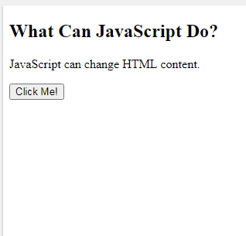
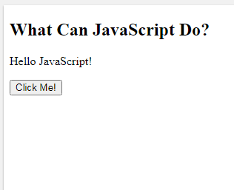
OUTPUT
SIT1302 School of Computing

Slide 5
JavaScript and Java are completely different languages, both in concept and design.
JavaScript was invented by Brendan Eich in 1995, and became an ECMA standard in 1997.
ECMA-262 is the official name of the standard. ECMAScript is the official name of the language.
Where To Write?
The <script> Tag
In HTML, JavaScript code is inserted between <script> and </script> tags.
<!DOCTYPE html>
<html>
<body>
<h2>JavaScript in Body</h2>
<p id="demo"></p>
<script>
document.getElementById("demo").innerHTML = "My First JavaScript";
</script></body>
</html>
SIT1302 School of Computing

Slide 6
JavaScript Functions and Events
A JavaScript function is a block of JavaScript code, that can be executed when "called" for.
For example, a function can be called when an event occurs, like when the user clicks a button.
JavaScript in <head> or <body>
You can place any number of scripts in an HTML document.
Scripts can be placed in the <body>, or in the <head> section of an HTML page, or in both.
JavaScript in <head>
In this example, a JavaScript function is placed in the <head> section of an HTML page.
The function is invoked (called) when a button is clicked
SIT1302 School of Computing

Slide 7
<!DOCTYPE html>
<html>
<head>
<script>
function myFunction() {
document.getElementById("demo").innerHTML = "Paragraph changed.";
}
</script>
</head>
<body>
<h2>JavaScript in Head</h2>
<p id="demo">A Paragraph.</p>
<button type="button" onclick="myFunction()">Try it</button>
</body>
</html>
SIT1302 School of Computing

Slide 8
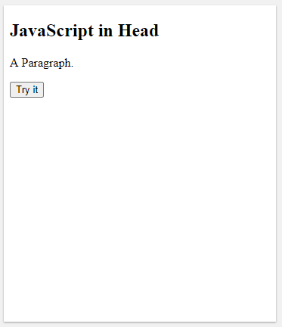
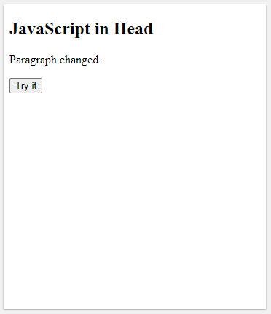
OUTPUT
SIT1302 School of Computing

Slide 9
JavaScript in <body>
In this example, a JavaScript function is placed in the <body> section of an HTML page.
The function is invoked (called) when a button is clicked
<!DOCTYPE html>
<html>
<body>
<h2>JavaScript in Body</h2>
<p id="demo">A Paragraph.</p>
<button type="button" onclick="myFunction()">Try it</button>
<script>
function myFunction() {
document.getElementById("demo").innerHTML = "Paragraph changed.";
}
</script>
</body>
</html>
SIT1302 School of Computing

Slide 10
OUTPUT
SIT1302 School of Computing

Slide 11
External JavaScript
Scripts can also be placed in external files:
External file: myScript.js
function myFunction()
{
document.getElementById("demo").innerHTML = "Paragraph changed.";
}
External scripts are practical when the same code is used in many different web pages.
JavaScript files have the file extension .js.
To use an external script, put the name of the script file in the src (source) attribute of a <script> tag:
<script src="myScript.js"></script>
SIT1302 School of Computing

Slide 12
<!DOCTYPE html>
<html>
<body>
<h2>External JavaScript</h2>
<p id="demo">A Paragraph.</p>
<button type="button" onclick="myFunction()">Try it</button>
<p>(myFunction is stored in an external file called "myScript.js")</p>
<script src="myScript.js"></script>
</body>
</html>
SIT1302 School of Computing

Slide 13
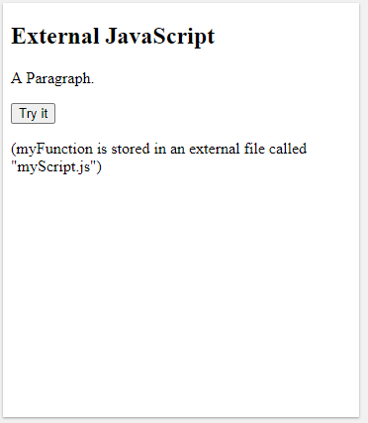
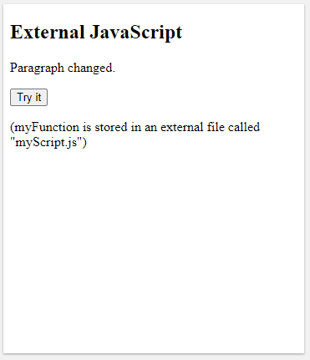
OUTPUT
SIT1302 School of Computing

Slide 14
You can place an external script reference in <head> or <body> as you like.
The script will behave as if it was located exactly where the <script> tag is located.
External scripts cannot contain <script> tags.
External JavaScript Advantages
Placing scripts in external files has some advantages:
It separates HTML and code
It makes HTML and JavaScript easier to read and maintain
Cached JavaScript files can speed up page loads
SIT1302 School of Computing

